Slide 1
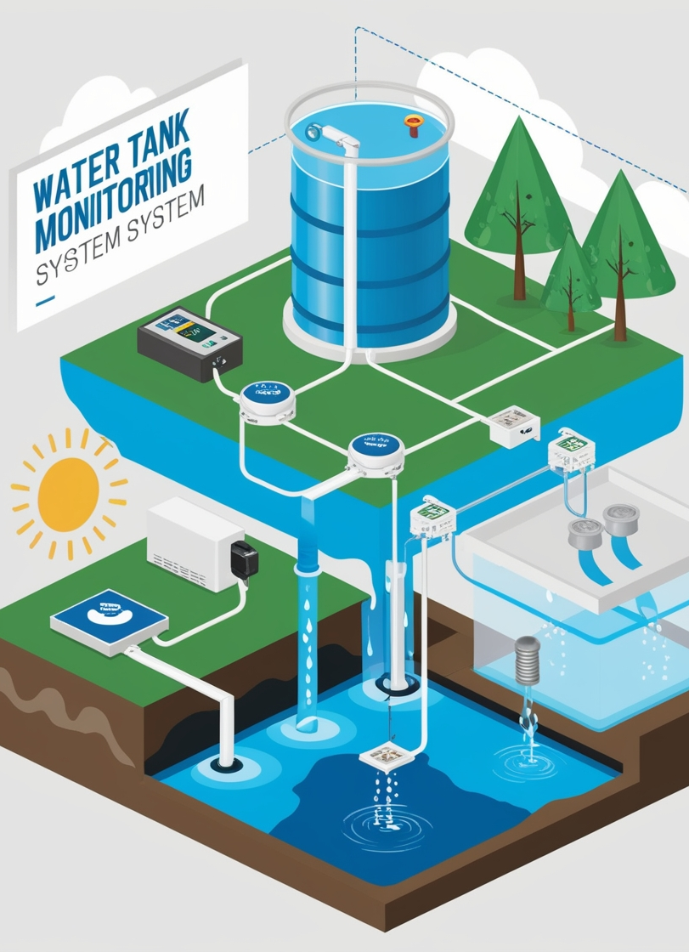
Aqua Guard
Smart Water Tank Monitoring System
By GROUP 9.1 PG01

Slide 2

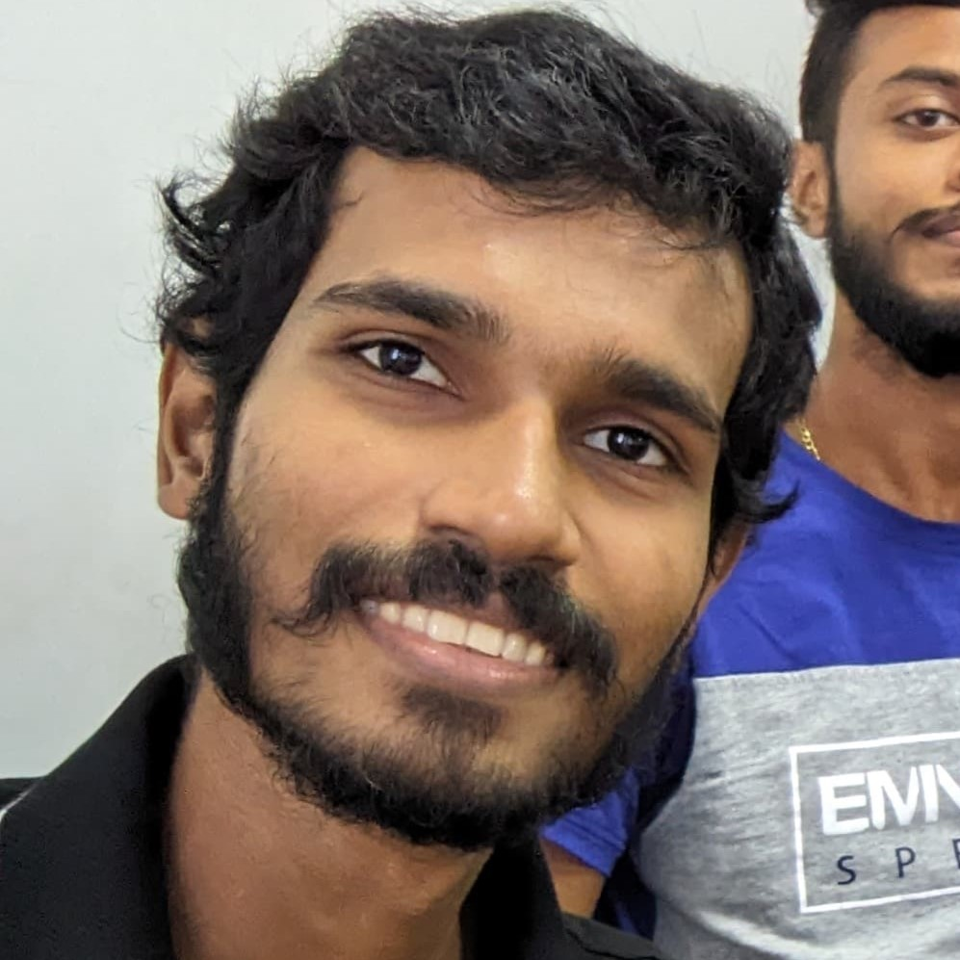



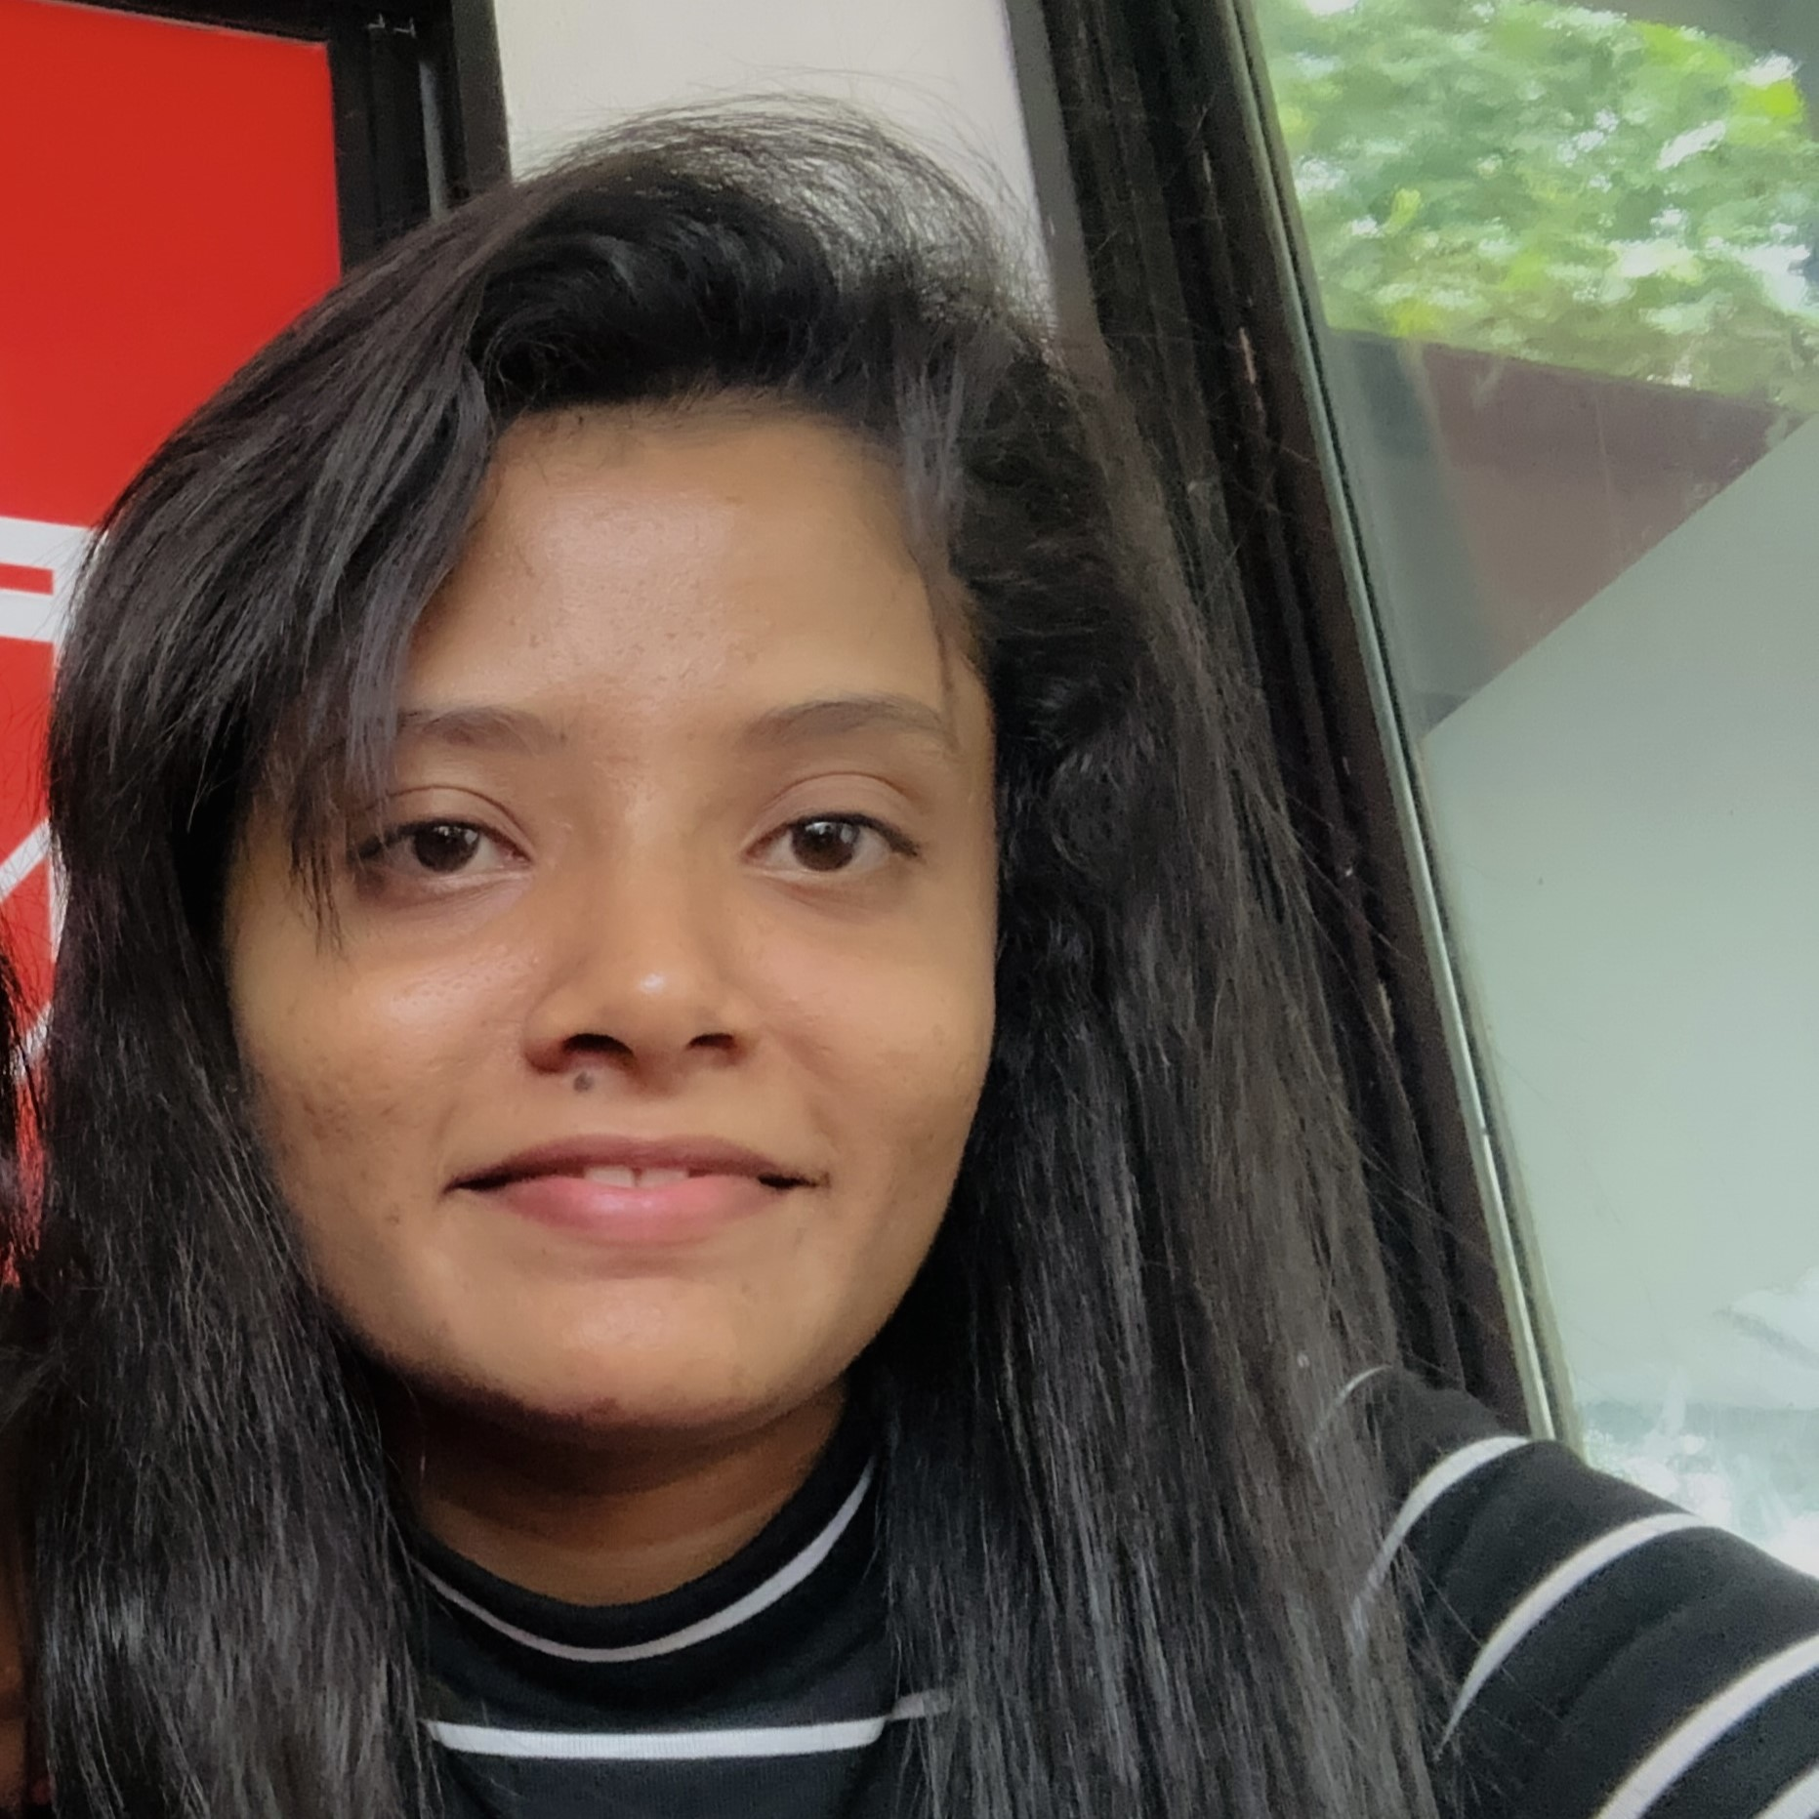
Our Team…
Hasindu
IT24102870
Naveen
IT24102019
Udama
IT24102178
Nisal
IT24102126
Sandeepa
IT24100400
Ramesha
IT24100162

Slide 3

Project Background
Water scarcity is a growing global problem. Traditional methods of monitoring water tanks are inefficient and often lead to waste. ‘Aqua Guard’ uses IoT technology to create a smart water tank monitoring system. The system will provide real-time data to improve water management, reduce waste, and help protect our environment.

Slide 4








Problem & Motivation
Problem
Many buildings still use outdated methods to monitor water tanks. This leads to wasted water, high costs, and poor water management. We need a better way to track water levels and usage to save water and money.
Motivation
We want to create a smart water tank system because the world is running out of usable sources of clean water. We need to use water wisely and reduce waste. This project will use technology to help manage water better.

Slide 5

Aim & Objectives
Aim
The Aqua Guard project will create a smart system to monitor water tanks. This system will use IoT technology to track water levels and usage. We want to save water, reduce waste, and improve water management.
Objectives
Identify user needs
Analyze existing solutions
Define system requirements
System architecture design
Select hardware components
Design software interfaces
Hardware assembly
Software development
Integration and testing
System deployment

Slide 6
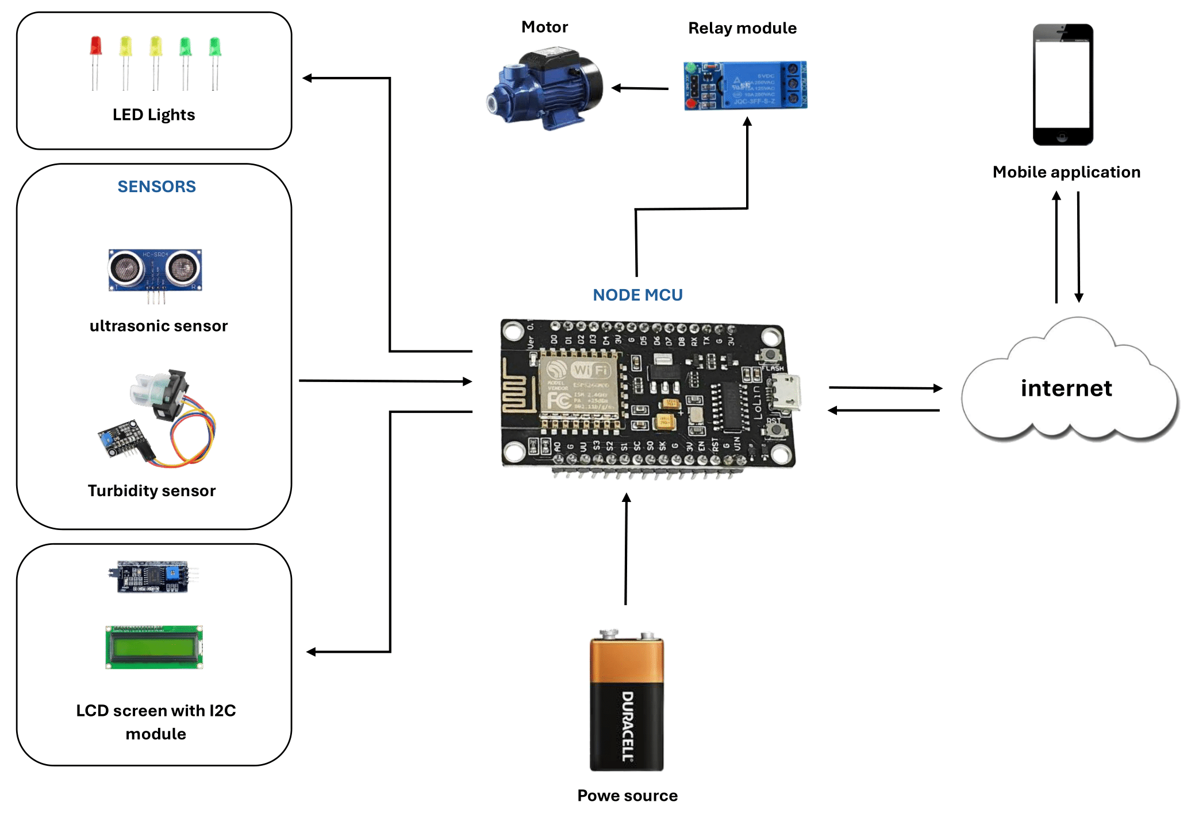
System Diagram

Slide 7

Methodology
Requirement Analysis and Planning
System Design
Development
Testing and Quality Assurance
Deployment and Integration

Slide 8

Evaluation Method
Functional Evaluation
Performance Evaluation
User Experience and Satisfaction Evaluation
Impact Evaluation
Continuous Monitoring and Improvement

Slide 9

Any Questions?

